Slide 1
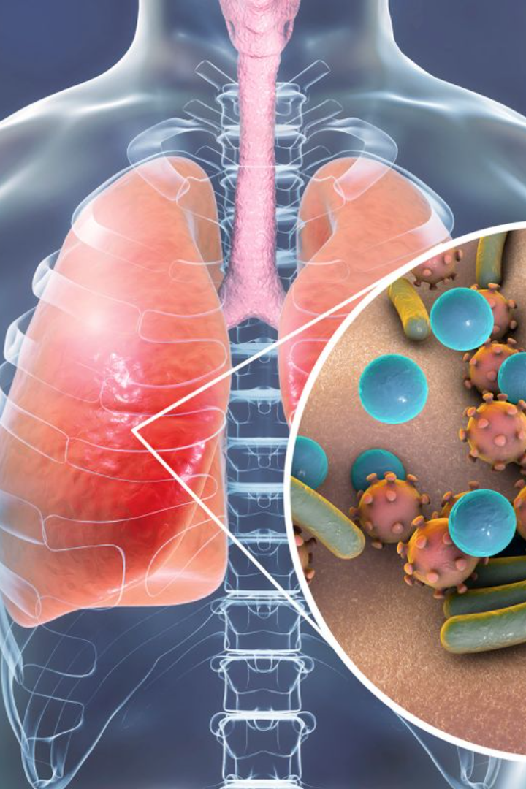
Detection of Pneumonia using Convolutional Neural Networks in Deep Learning
VALLAMBHOTLA SANTOSH KUMAR (20471A4358)
SHAIK NADEEM (21475A4304)
MADASU SRIRAM (20471A4331)
THOTA SAI VAMSI (21475A4301)
PROJECT GUIDE:
M. RAMAKRISHNA REDDY M.Tech (PH.D)Asst.Professor

Slide 2
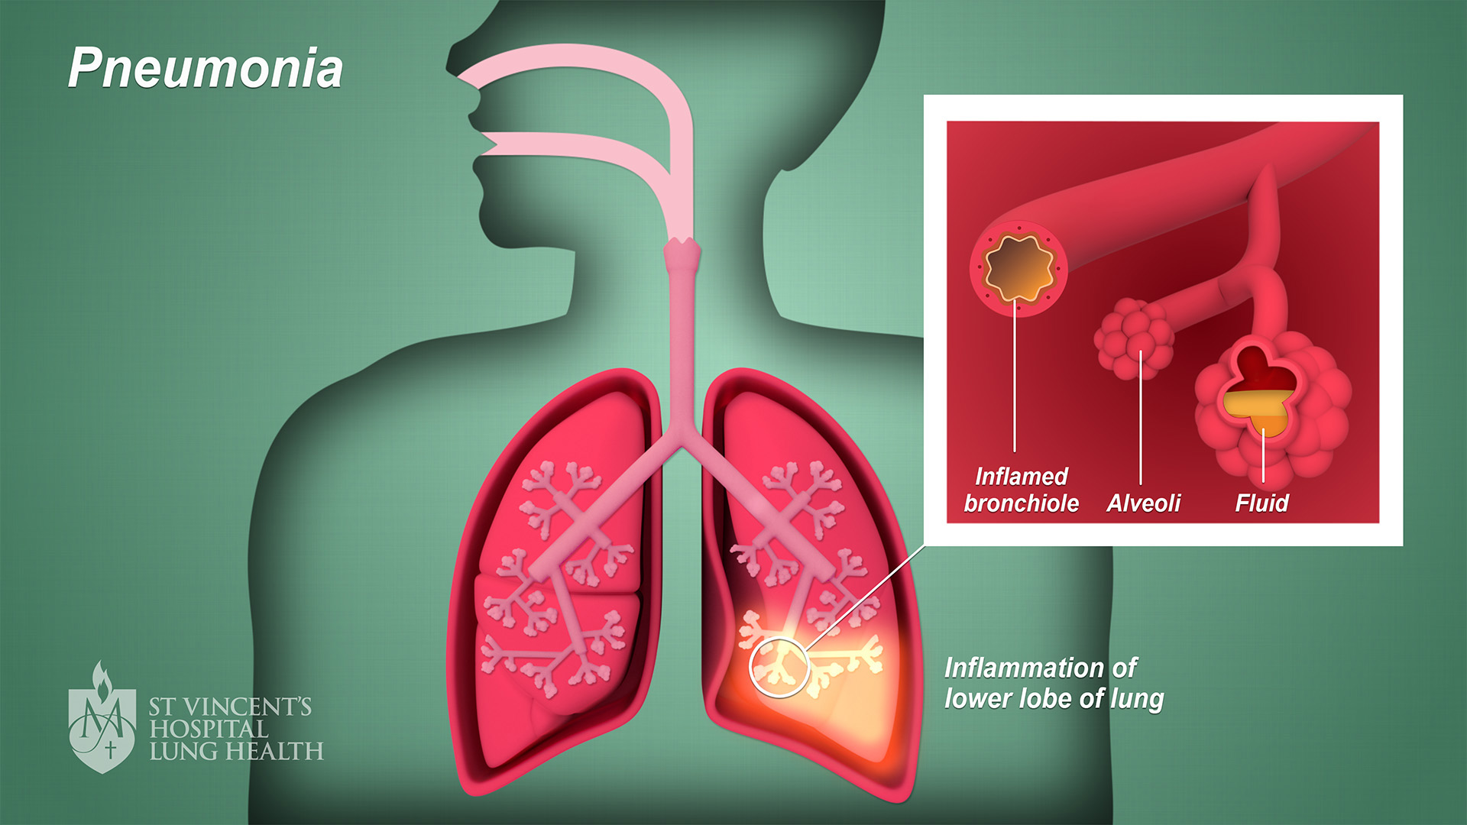
Outline
Introduction
Objective
Motivation
Flow chart
Techniques
Training Data
Testing and Final Output
Conclusion

Slide 3

Introduction
Pneumonia is a respiratory illness characterized by pulmonary inflammation, primarily affecting the air sacs known as alveoli. Bacteria, viruses, and fungus can all cause it. Effective treatment and patient outcomes depend on the timely and accurate identification of pneumonia. Traditional diagnostic approaches, such as chest X-rays and clinical examinations, can take time and may necessitate specialized knowledge.
Deep learning algorithms, particularly Convolutional Neural Networks (CNNs), have exhibited exceptional effectiveness in a variety of medical image processing applications in recent years. The goal of this project is to use CNNs to detect pneumonia from chest X-ray pictures, providing a faster and perhaps more reliable diagnostic tool.

Slide 4
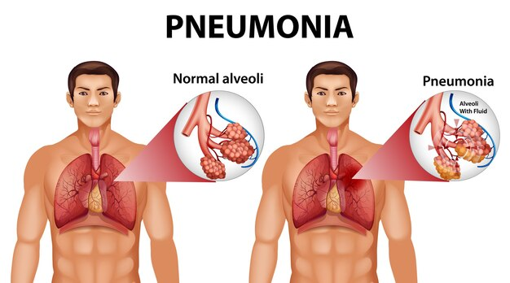

Objective
Automated Pneumonia Detection: Develop a CNN-based model capable of automatically identifying pneumonia from chest X-ray images.
Efficient Diagnosis: Improve the speed and efficiency of pneumonia diagnosis by providing a tool that can analyze images rapidly and accurately.
Reduced Dependency on Expertise: Enable healthcare professionals with varying levels of expertise to utilize the automated system, potentially reducing the burden on radiologists and facilitating quicker patient care.
Enhanced Patient Outcomes: Timely detection of pneumonia can lead to prompt treatment, contributing to better patient outcomes and reducing the risk of complications.

Slide 5
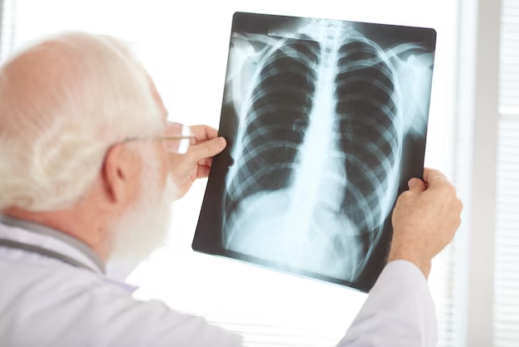
Motivation
The goal of this research is to create an automated pneumonia diagnosis system using deep learning and Convolutional Neural Networks (CNNs). The motivation stems from the need for timely pneumonia diagnosis, addressing workforce challenges in healthcare, improving accuracy and consistency in medical imaging interpretation, providing accessibility in resource-limited settings, capitalizing on technological advancements, and potentially saving lives through early detection. The goal of the project is to develop a user-friendly system that can efficiently interpret chest X-ray pictures, minimizing the need for specialist radiologists and leading to better patient outcomes. Deep learning's iterative nature enables for continual learning and modification, assuring the system's flexibility to changing medical data and imaging technology. The ultimate goal is to install a useful tool that aids in the automation of pneumonia diagnosis.

Slide 6

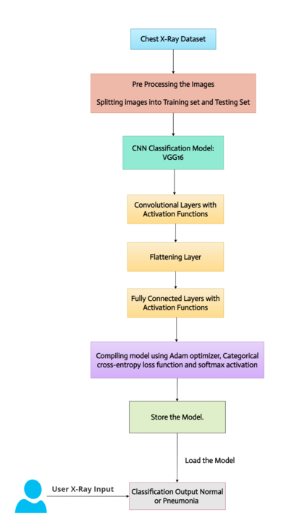
Flow chart
Data Collection:
Gather a diverse dataset of chest X-ray images the dataset for normal and pneumonia-affected cases.
Preprocessing:
Apply normalization, resizing, and augmentation to the dataset, Enhance the dataset for training and evaluation.
Model Architecture Design:
Design a CNN architecture suitable for pneumonia detection.(VGG16)
Training:
Train the CNN model using the preprocessed dataset and Implement transfer learning.
Validation:
Evaluate the model's performance on a separate validation set.
Evaluation:
Assess the model's performance on a test set using metrics like accuracy, sensitivity, specificity, and ROC-AUC.
Deployment:
Deploy the automated pneumonia detection system and Users upload chest X-ray images for automated analysis.
Results:
Provide detection results to users.
Display the system's findings, indicating normal or pneumonia-affected cases.

Slide 7
Techniques
VGG16:
This Convolutional Neural Network (CNN) architecture is simple and widely used for ImageNet, a large visible database mission used in research on visual object detection software.
Transfer learning (TL):
This deep learning technique is centered around using a neural network that has already been trained, storing the knowledge it gains from solving a particular problem, and then applying that knowledge to new datasets.
Tensor Flow:
An open-source machine learning package called TensorFlow is used to compute numbers using data flow graphs. Artificial intelligence and machine learning are two uses for it.
Keras:
It is a Python module for deep learning that runs on the top of TensorFlow library
SciPy :
SciPy is a free and open-source Python module used for technical and scientific computing. As we require Image Transformations in this article we have to install SciPy module
GLOB:
In Python, the glob module is used to retrieve files/pathnames matching a specified pattern.

Slide 8
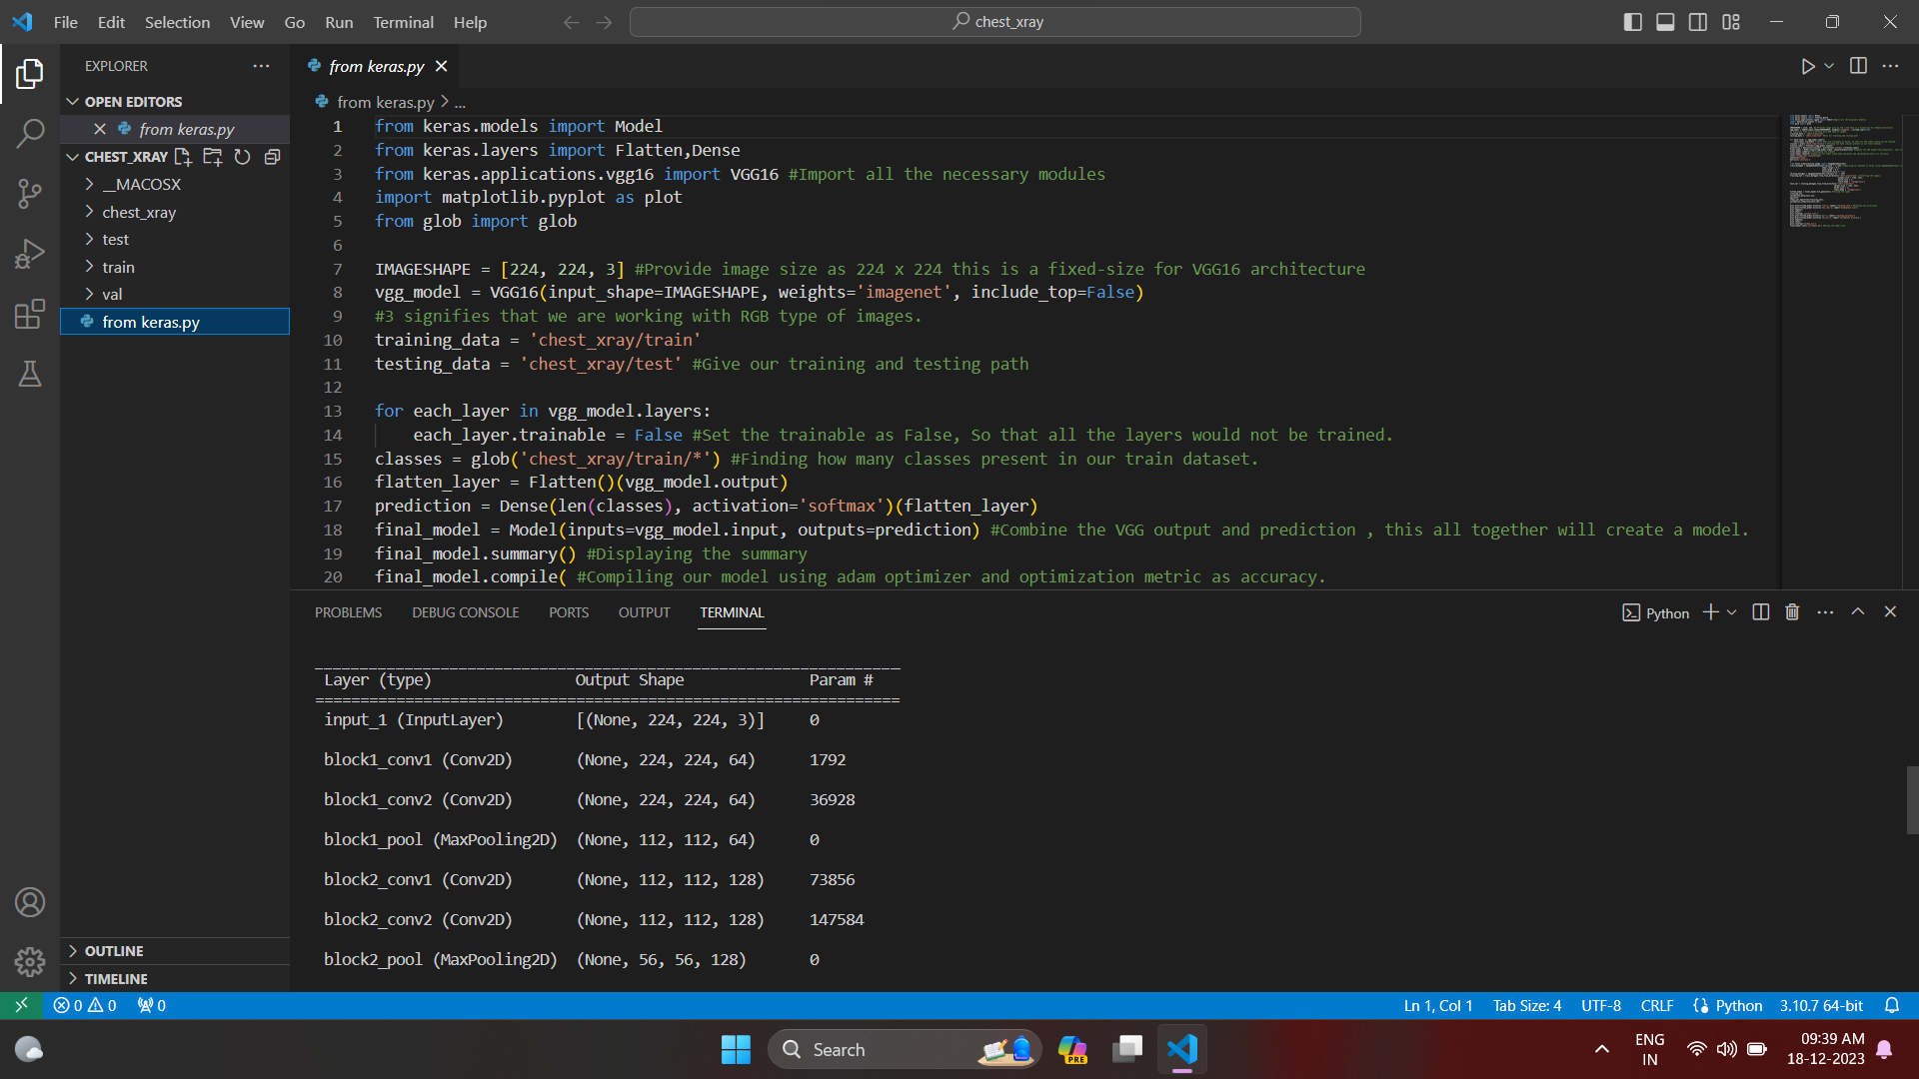
TRAINING DATA

Slide 9
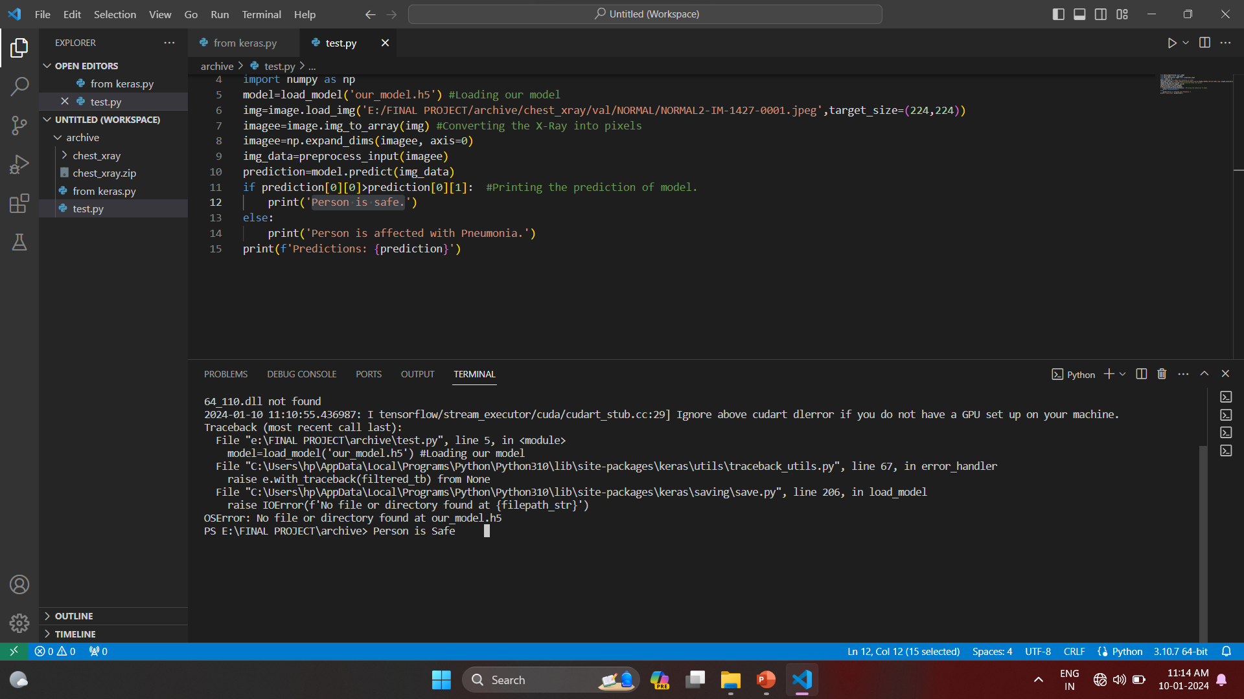
TESTING DATA & FINAL OUTPUT

Slide 10
Conclusion
In conclusion, the pneumonia detection project leveraging Convolutional Neural Networks (CNNs) successfully addressed the crucial demand for rapid and accurate pneumonia diagnosis by automated analysis of chest X-ray images. The experiment achieved outstanding accuracy and efficiency, perhaps paving the way for a breakthrough in medical picture analysis.
The system's accuracy in discriminating between normal and pneumonia-affected cases, lowering the stress on healthcare personnel, and increasing accessibility in a variety of healthcare settings are among the system's key achievements. The system's deployability is improved by the user-friendly interface.
Improving data diversity, introducing continuous learning mechanisms, integrating the system into clinical workflows, and improving model interpretability are all viable areas for future advancement. Finally, the project represents a promising achievement at the interface of deep learning and medical diagnostics, with future applications.

Slide 11
Thank you
For this oppurtunity

